Slide 1
AWS Developer: Introduction to AWS Lambda

Slide 2
Evolution of Serverless Functions

Slide 3
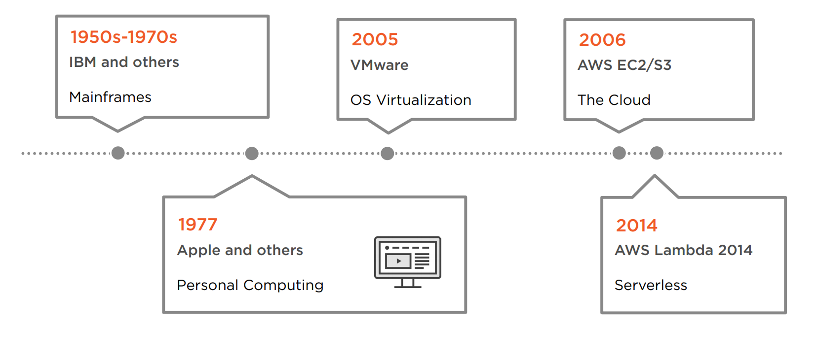
Serverless vs. Traditional Architecture

Slide 4
Mainframes
- Large space requirement
- Installation
- Maintenance
- Cost
- Inflexibility

Slide 5
Personal Computing / Minicomputers
Lower barriers to entry
Reduced cost
Increased distribution

Slide 6
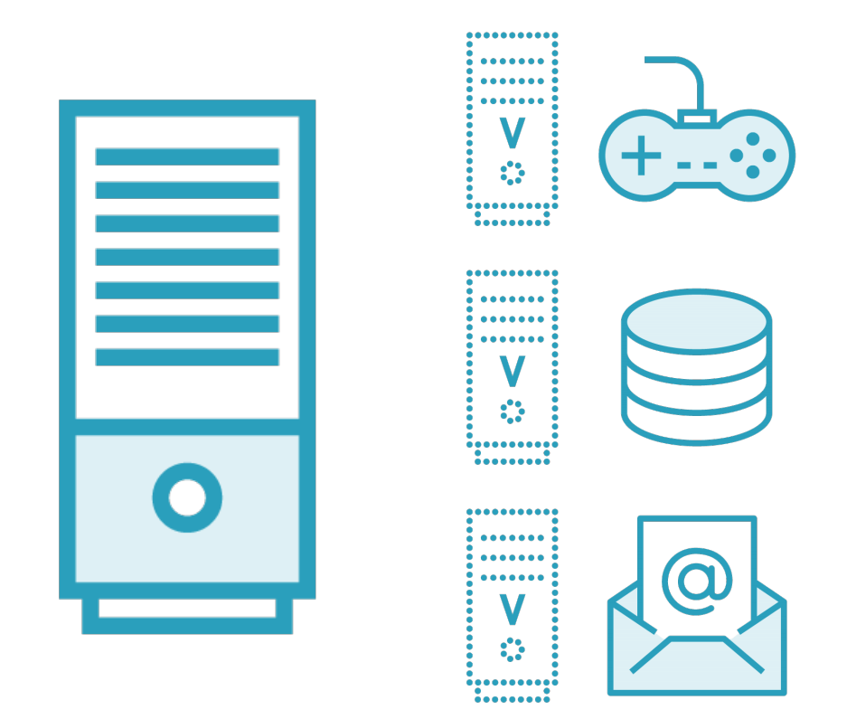
Virtualization and Hypervisors

Slide 7
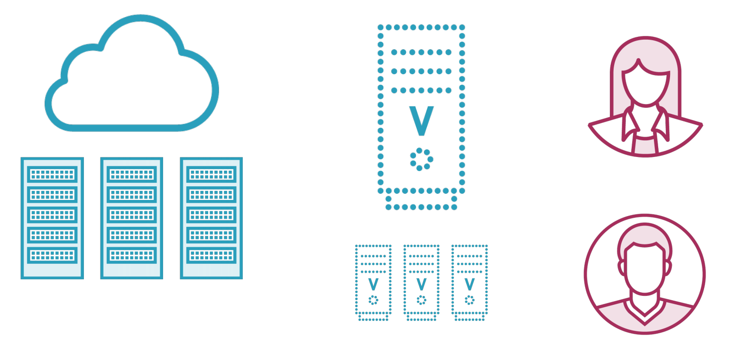
The Cloud - Amazon EC2

Slide 8
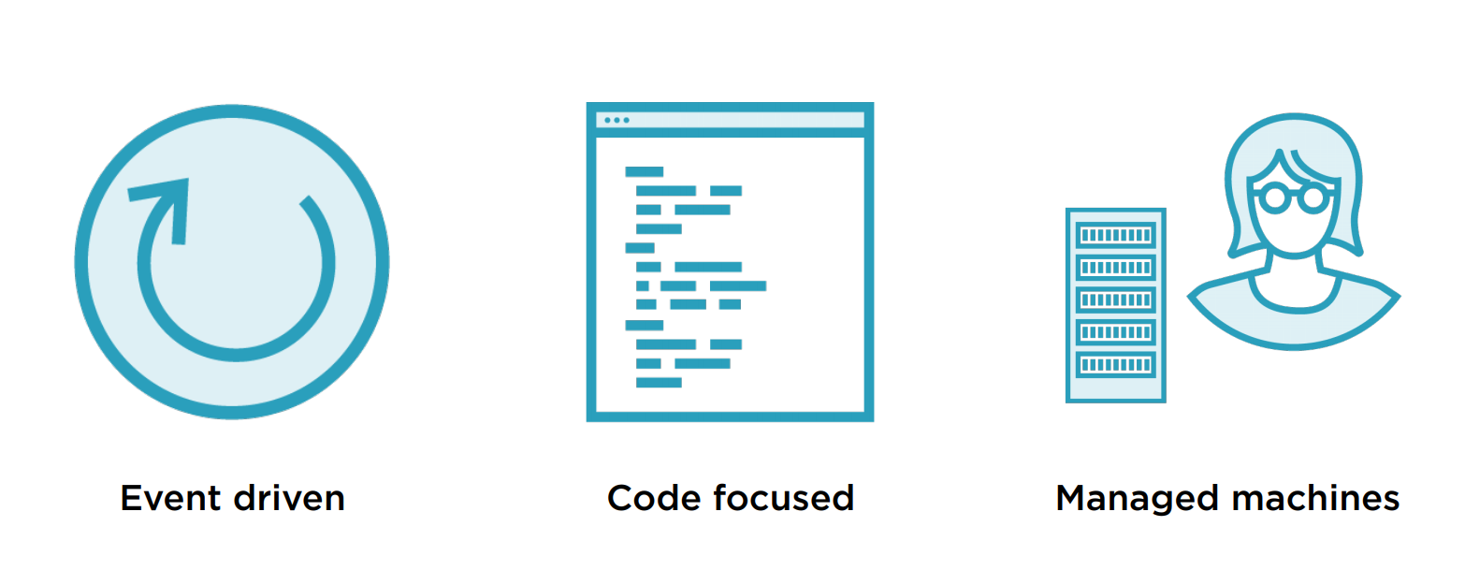
Serverless Functions

Slide 9
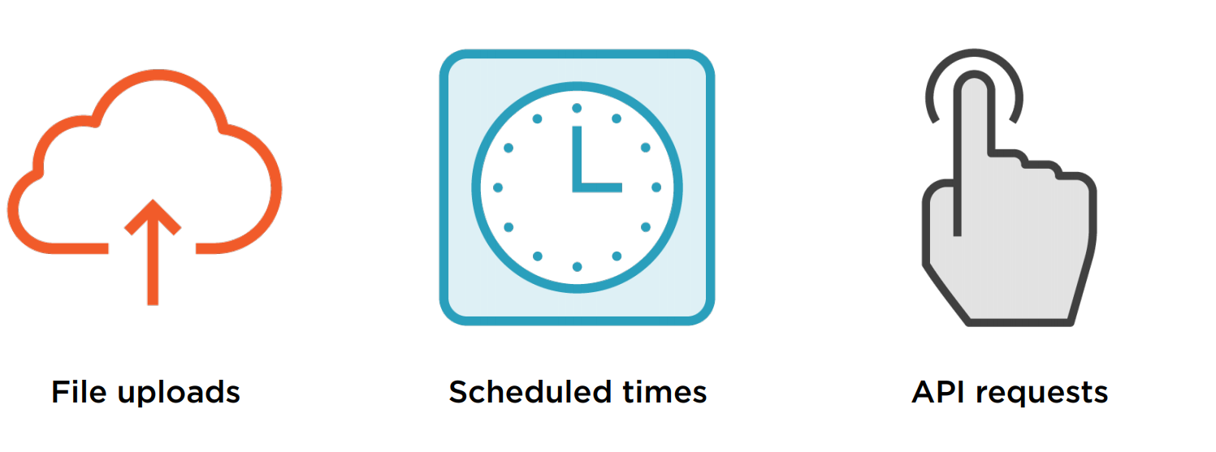
Event Examples

Slide 10
Serverless Benefits and Challenges
Benefits
Cost and utilization
Managed machines
Service integrations
Scaling
Challenges
Debugging
Control
Cutting edge quirks

Slide 11
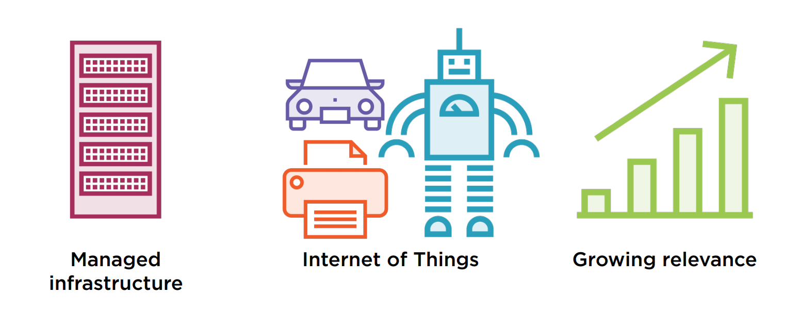
Why Learn Lambda?

Slide 12
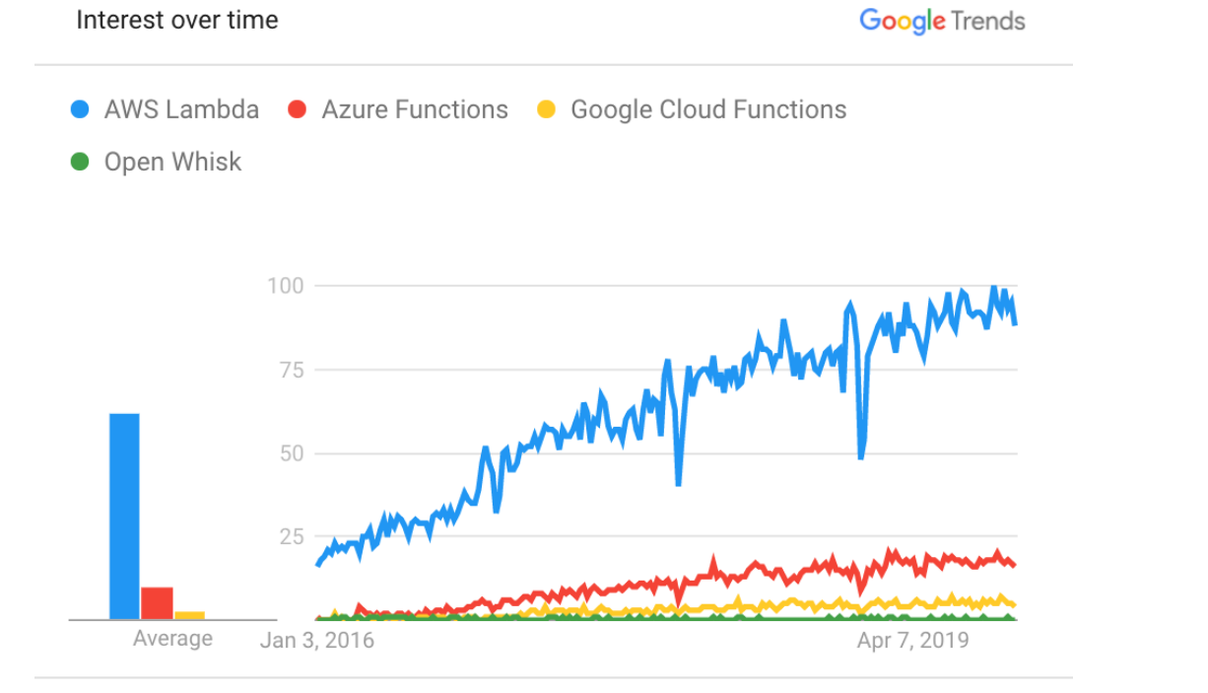
Lambda’s Growing Relevance

Slide 13
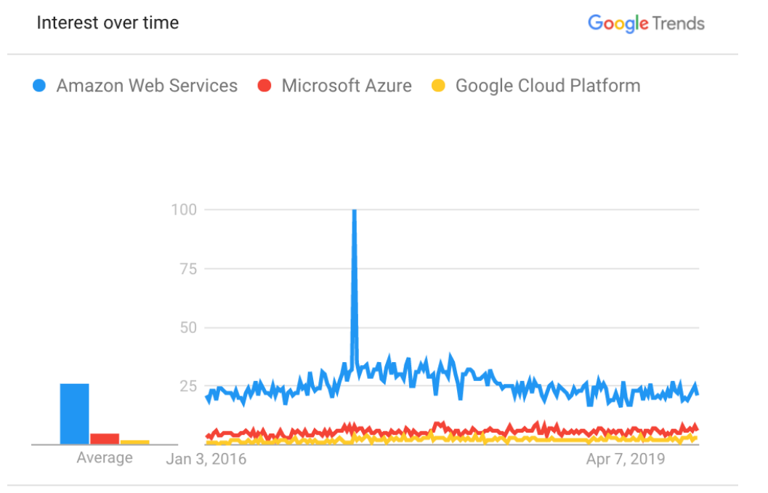
AWS and Competitors

Slide 14
How Is Lambda Used?
Stream data processing
Easy & scalable APIs
Photo processing
Web applications

Slide 15
Serverless Function Providers

Slide 16
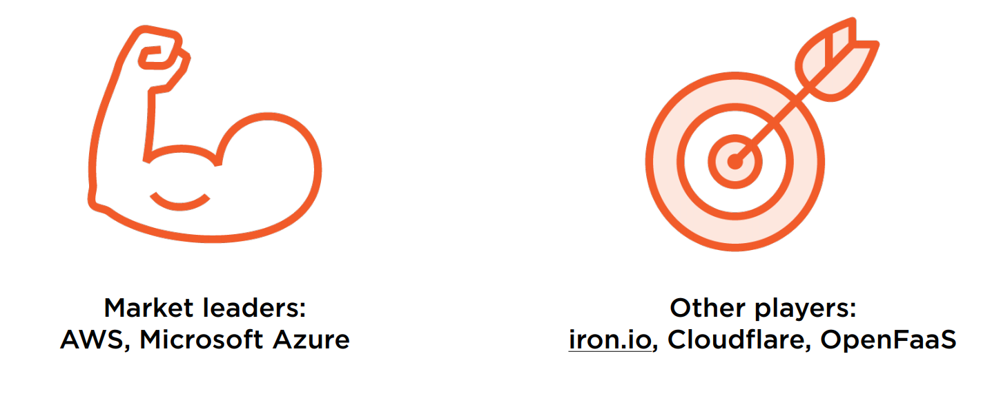
Prominent Serverless Function Providers

Slide 17
Market Leader Comparison
AWS Lambda
Node, Python, Java, C#, PowerShell, Ruby, Go, user-provided runtimes
Built-in versioning
HTTP endpoints via API Gateway
15 minute running time limit
1000 concurrent functions (soft limit)
Azure Functions
Node, Python, Java, C#, PowerShell, F# PHP, batch, bash, other executables
No built-in versioning
HTTP endpoints via API Management
10 minute limit (option for unlimited)
10 concurrent instances

Slide 18
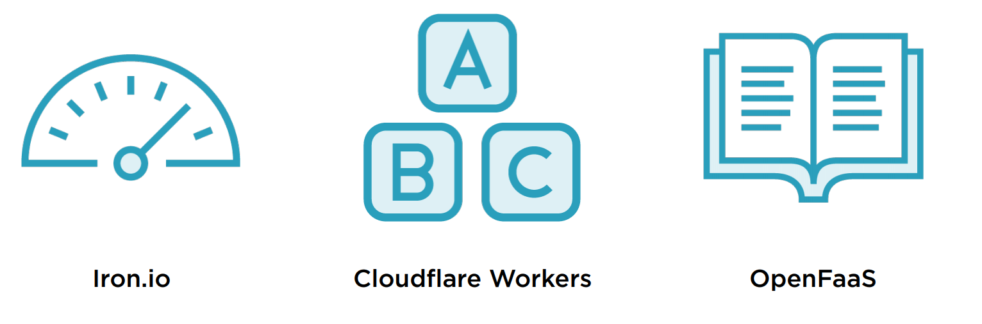
Niche Providers

Slide 19
Working with AWS

Slide 20
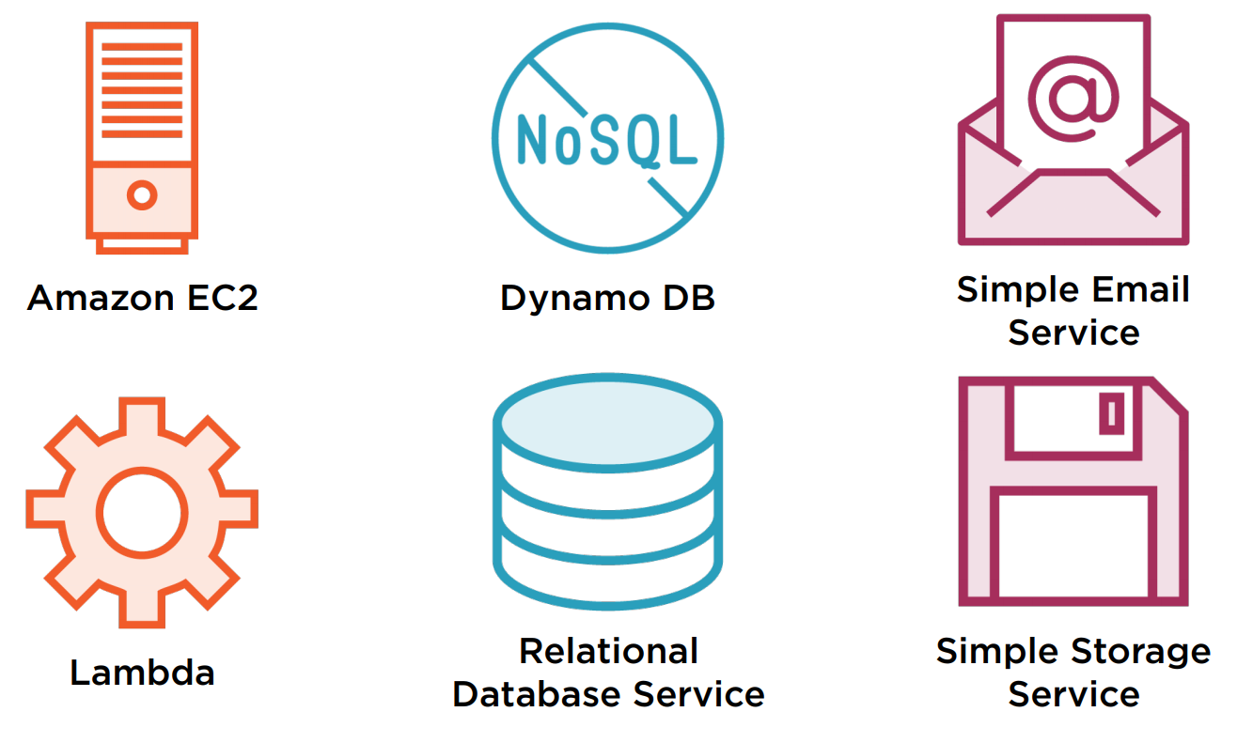
AWS Free Tier - 12 Months of Free

Slide 21
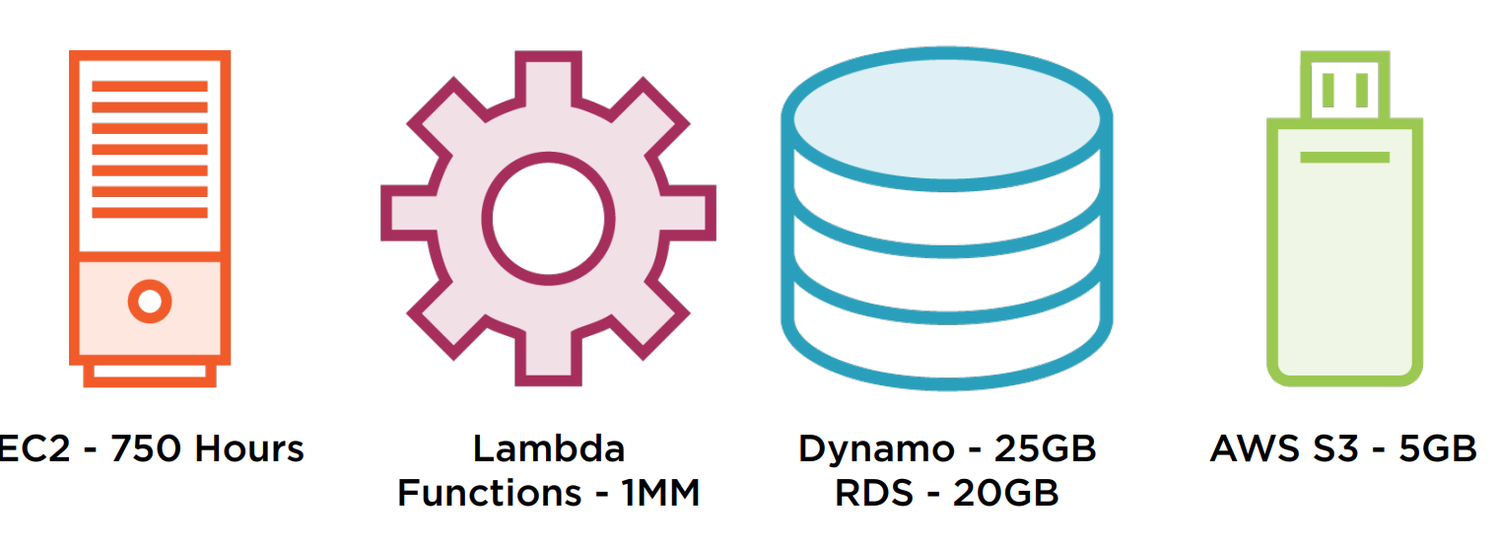
Free Tier Examples

Slide 22
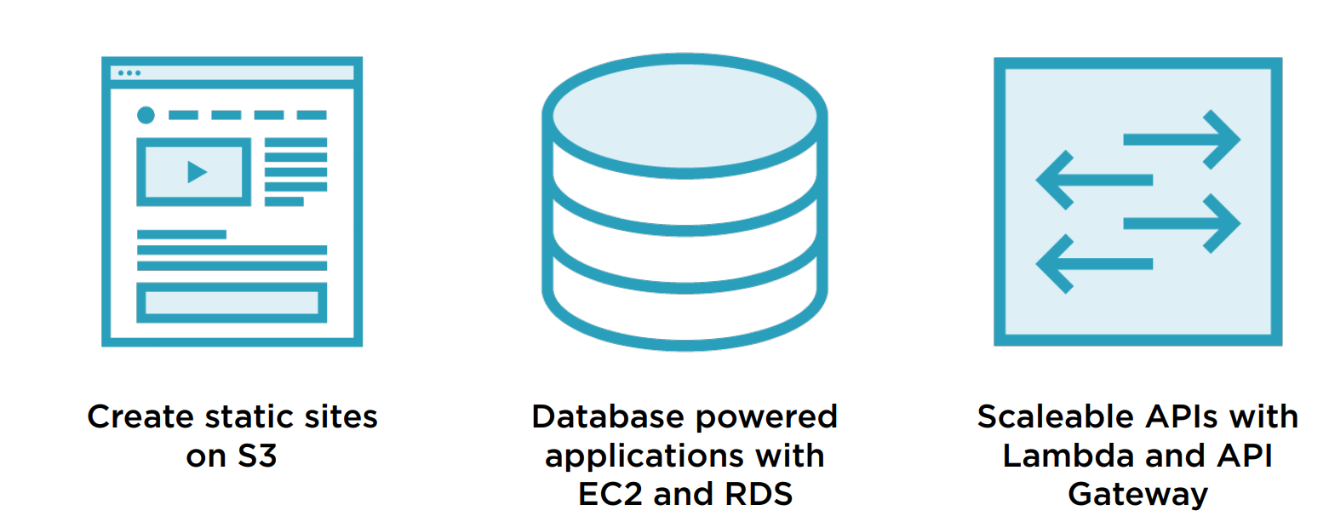
Building with Free Tier

Slide 23
Starting with Lambda Functions

Slide 24
Languages and Runtimes
Example languages: Python, Node.js, Java, Go
Example runtimes: Python 3.8, Node.js 12.13.0

Slide 25
AWS-managed Languages and Runtimes
Node.js
Python
Ruby
Java
Go
.NET Core (C# and PowerShell)

Slide 26
Custom Runtimes
Rust
C++
PHP

Slide 27
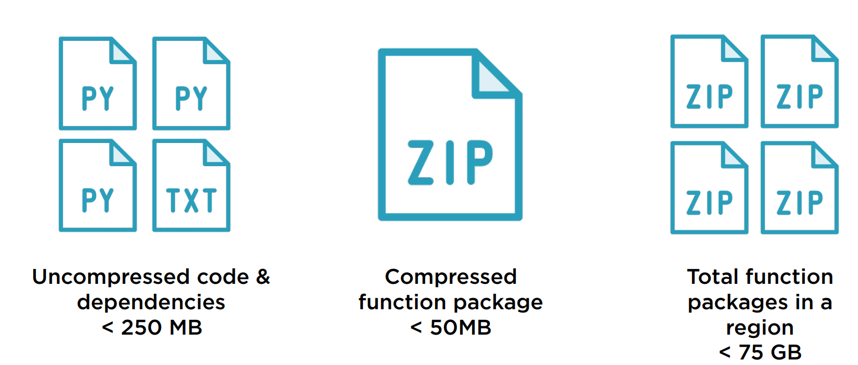
Size Limitations

Slide 28
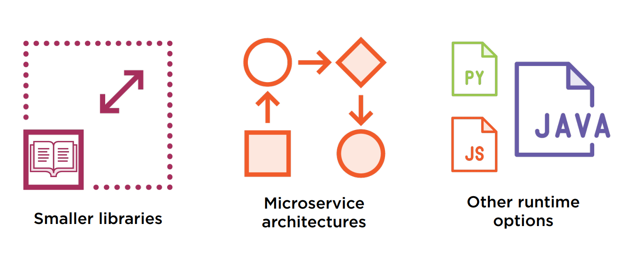
Size Limitations - Workarounds

Slide 29
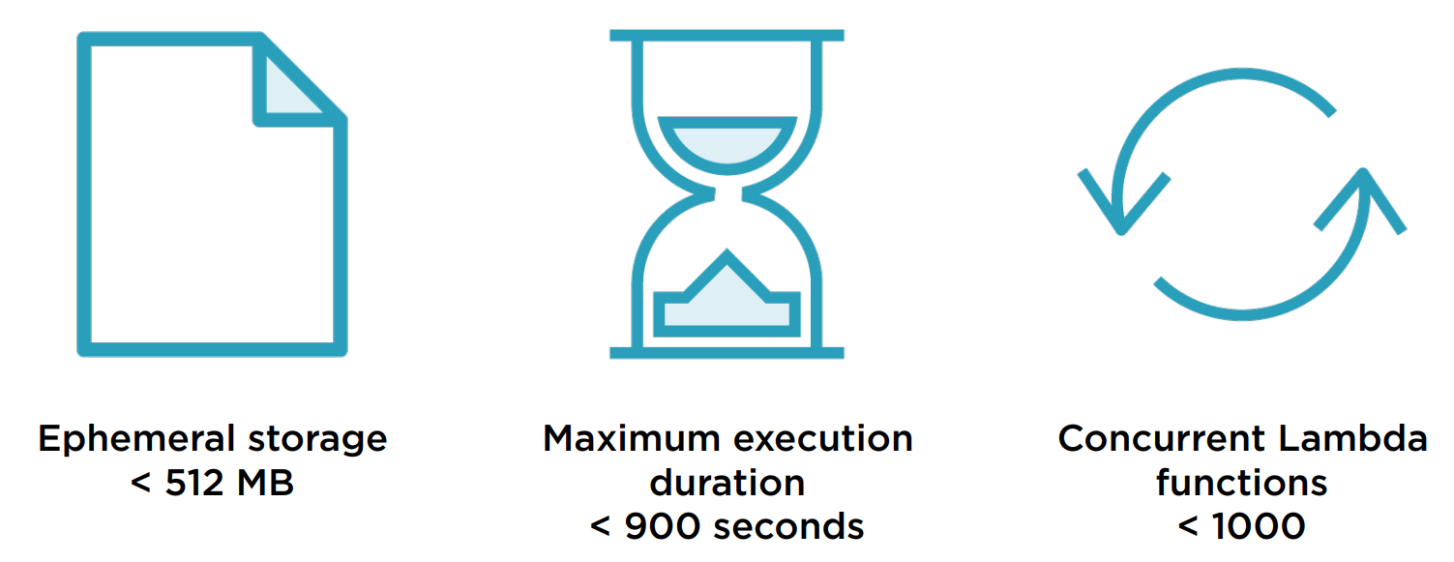
Resource Limitations

Slide 30
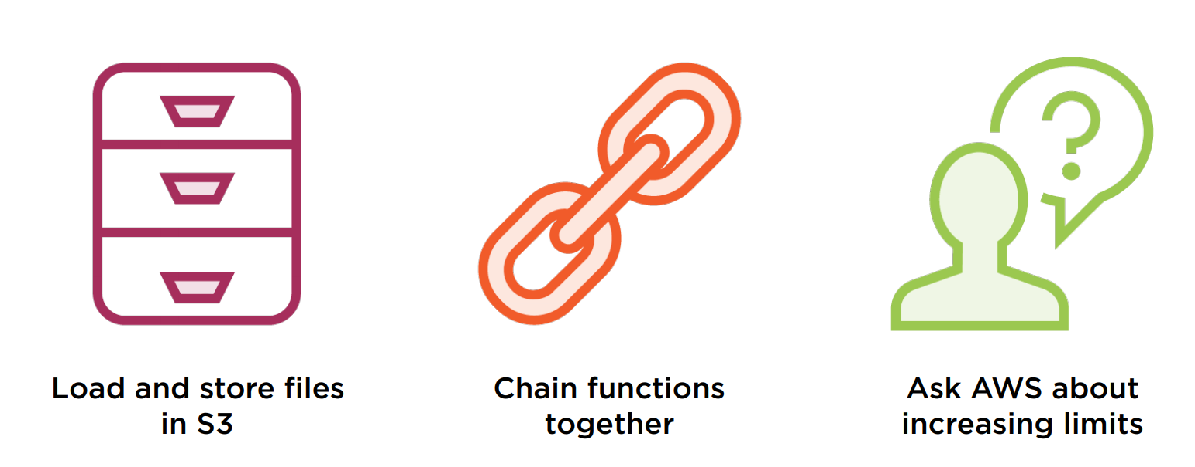
Resource Limitations - Workarounds

Slide 31
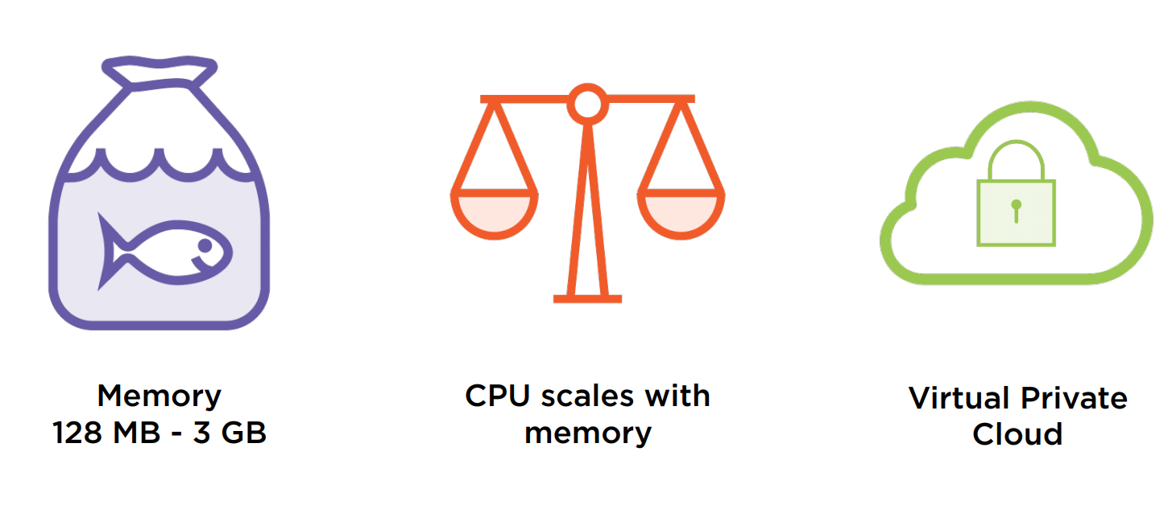
Memory, CPU and VPC

Slide 32
AWS Lambda Considerations
Event Driven Code
Code size limitations
Lambda as a component
Performance
limitations
Long Running Workloads

Slide 33
Lambda Prerequisites

Slide 34
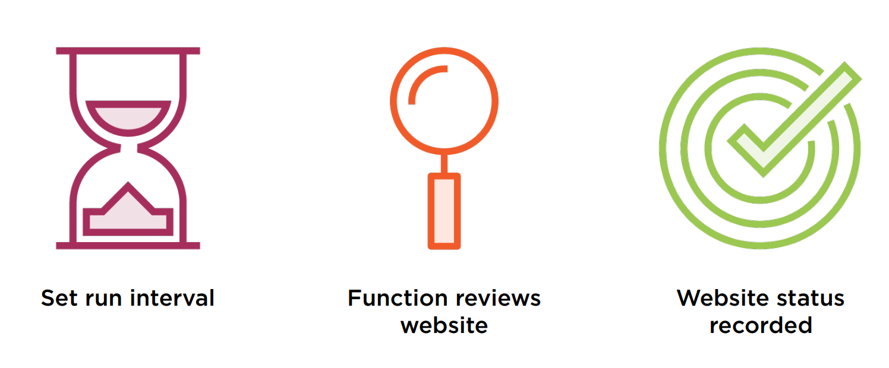
Lambda Canary

Slide 35
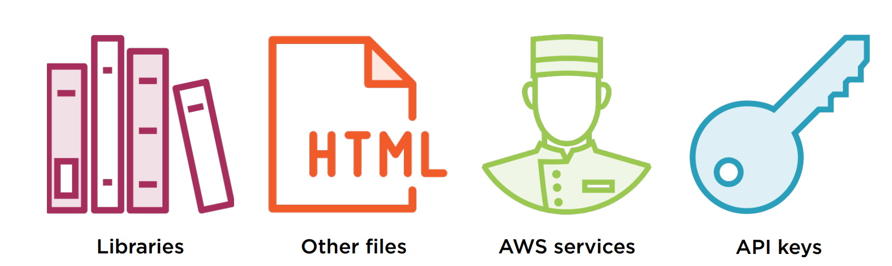
Gathering Dependencies

Slide 36
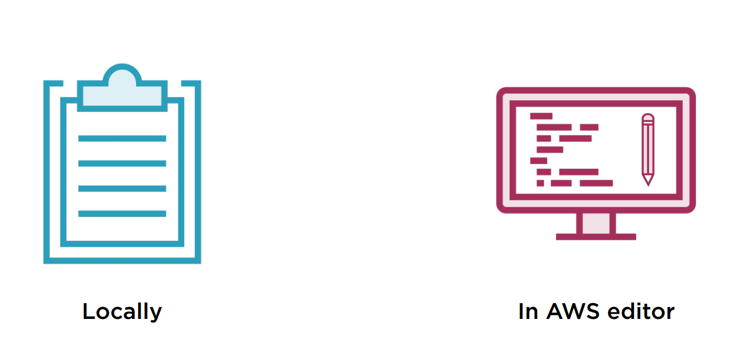
Writing Code

Slide 37
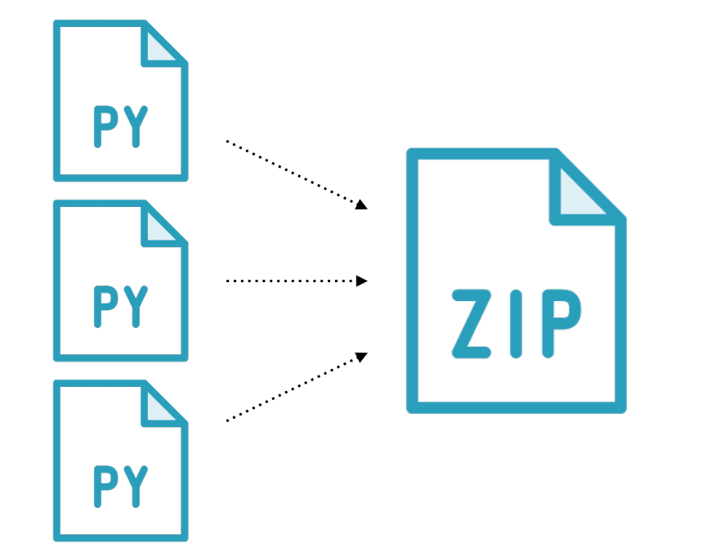
Creating a Function Package

Slide 38
Debugging
Use logging and CloudWatch
Environment differences
Search for your issues
Consider 3rd party tools

Slide 39
Using Lambda with 3rd Party APIs

Slide 40
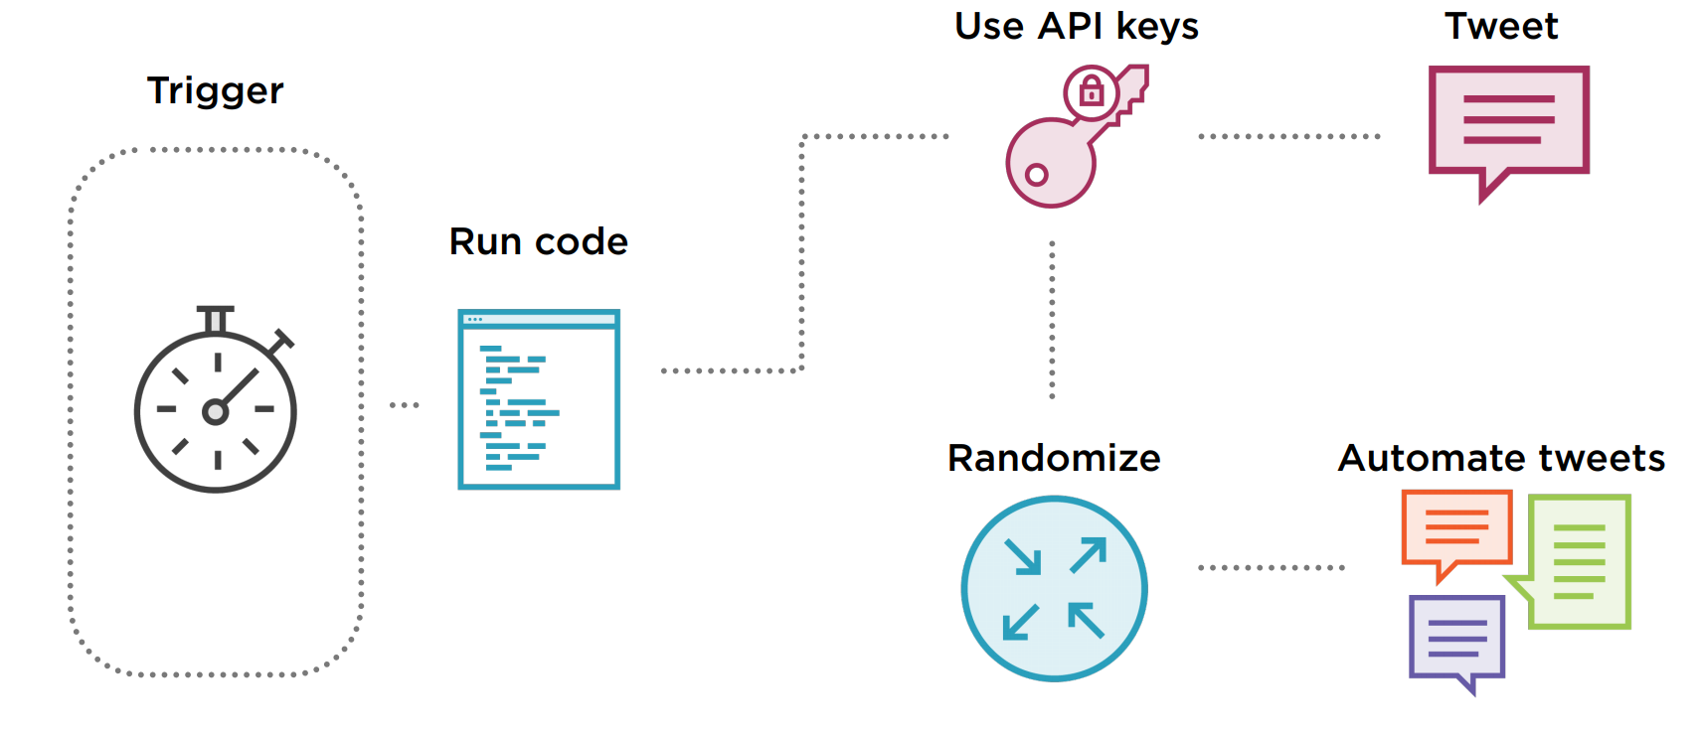
Determine Functionality - Twitter Bot

Slide 41
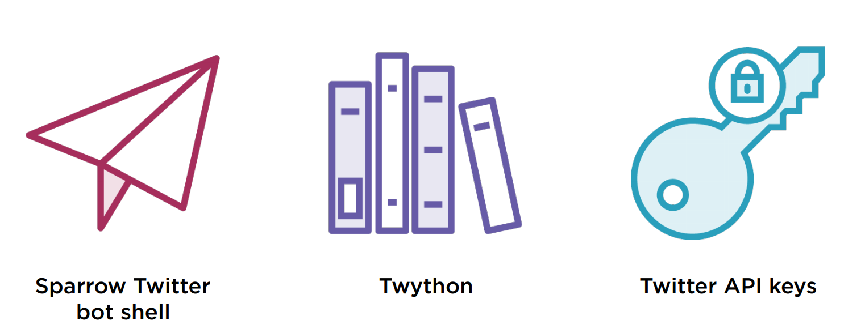
Credentials and Libraries

Slide 42
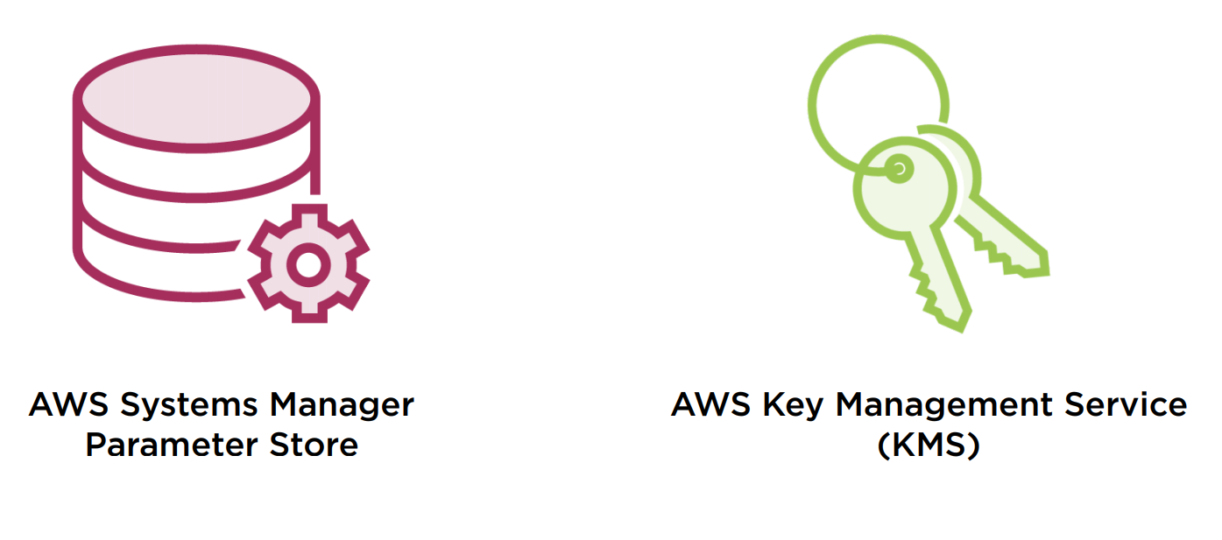
API Key Management Options

Slide 43

Data Encryption

Slide 44

Key Encryption

Slide 45
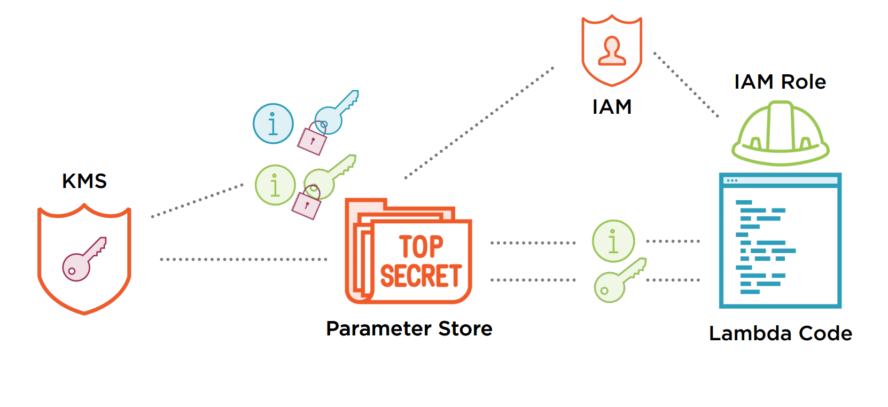
Parameter Store and KMS

Slide 46
Integrating Lambda & Other AWS Services

Slide 47
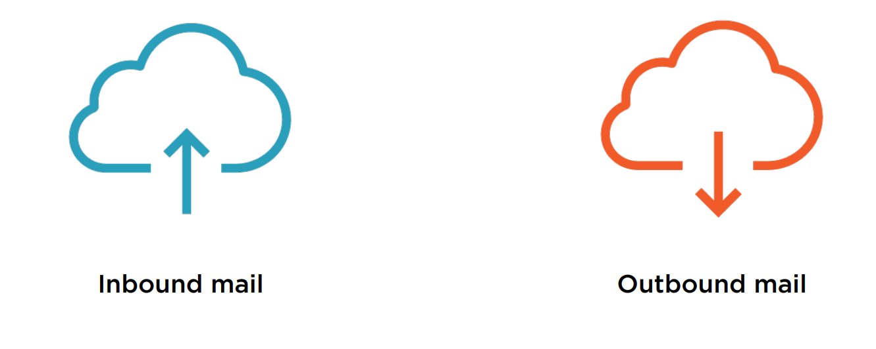
Amazon Simple Email Service (SES)

Slide 48
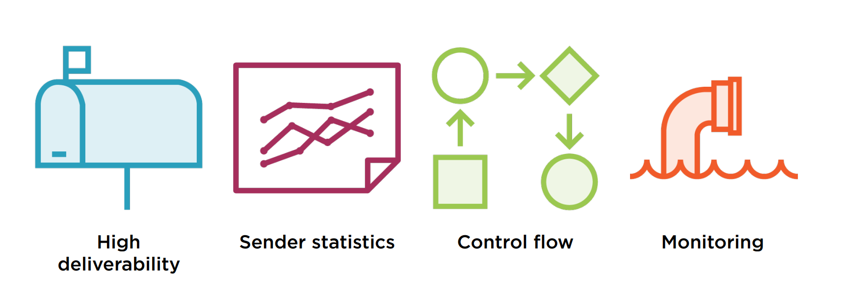
Benefits of SES

Slide 49
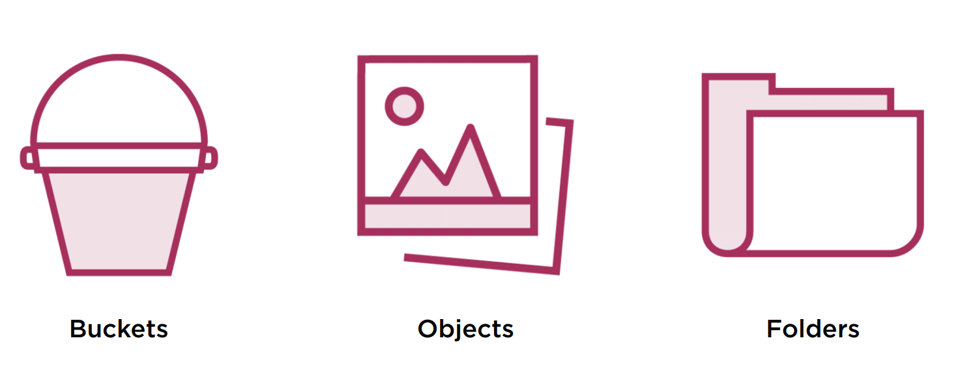
Amazon Simple Storage Service (S3)

Slide 50
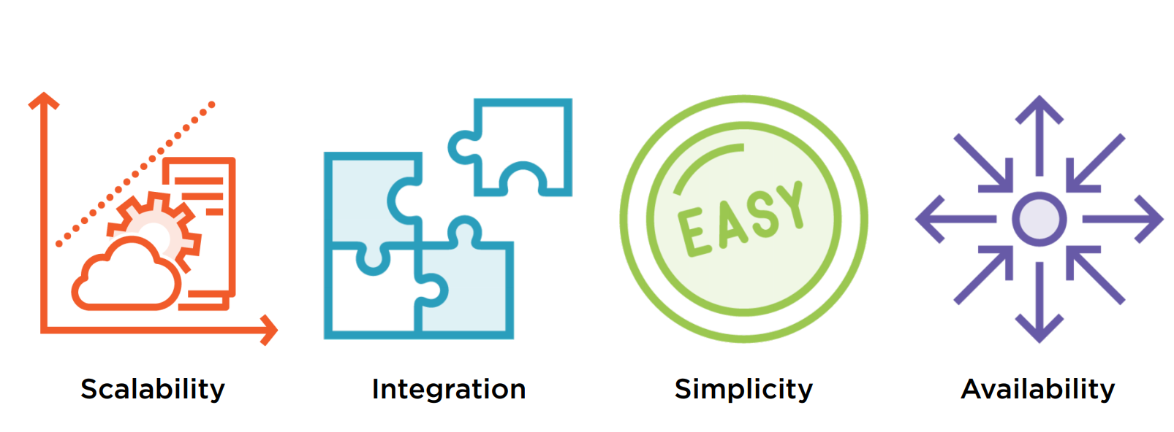
Benefits of S3

Slide 51
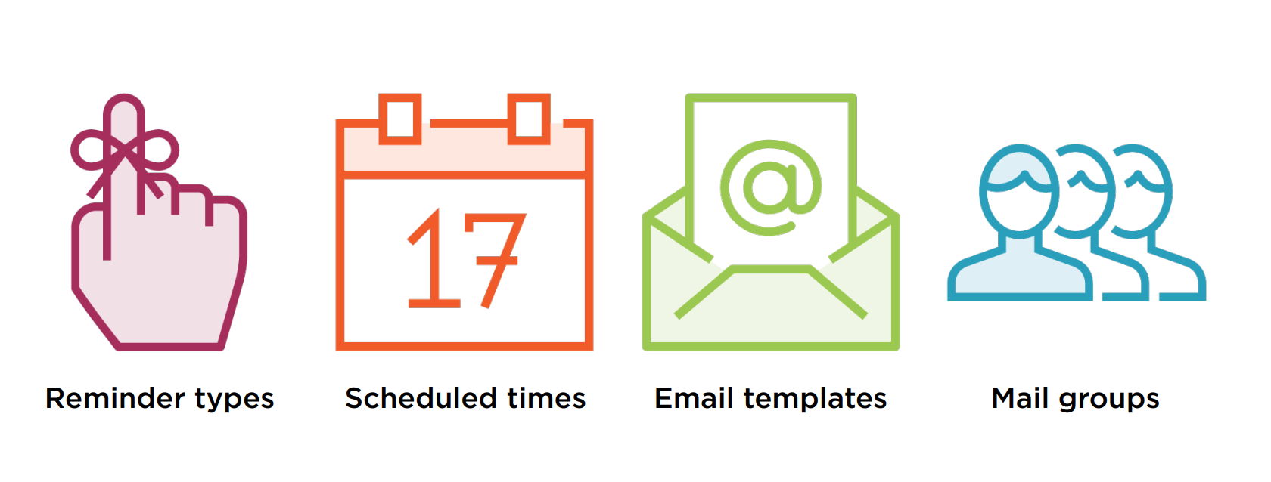
Cuckoo - Our Skeleton Code

Slide 52
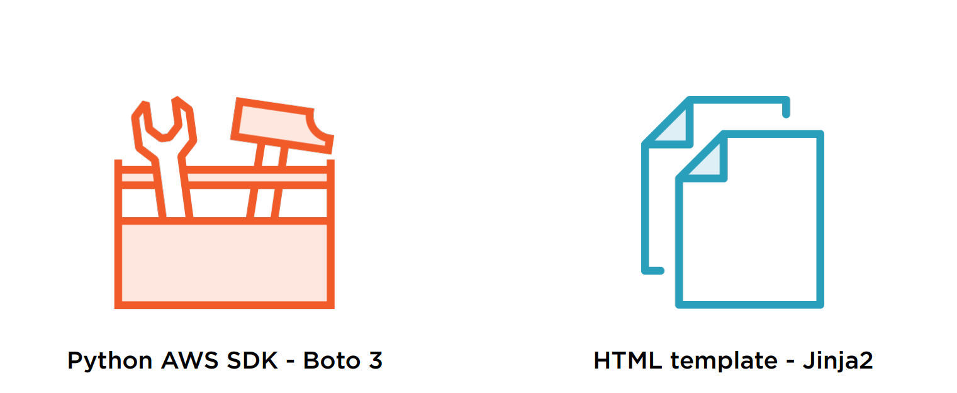
Other Resources

Slide 53
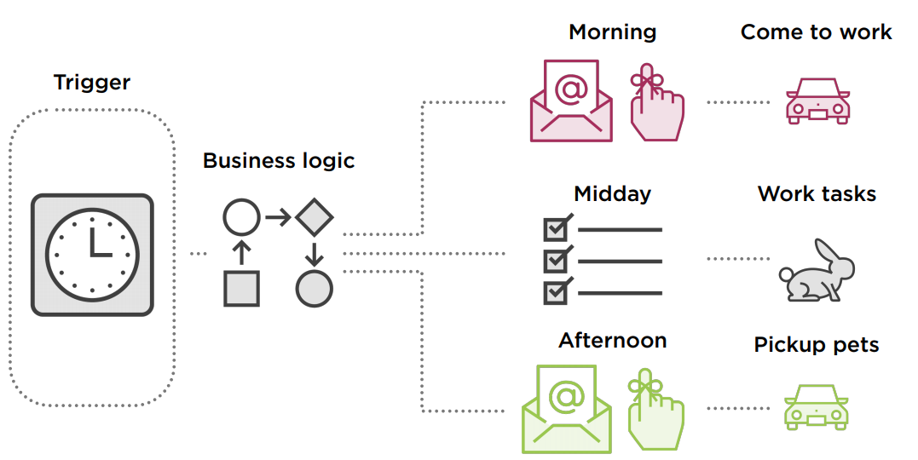
Workflow Automation

